Slide 1



Slide 2

QR Based License Detector
Supervised by:
Mr. Najam Dar
Group Members:
Saadia Mumraiz (FA19-MCS-019)
Mariyam Arif (FA19-MCS-023)
Department of Computer Science
COMSATS University Islamabad, Attock Campus

Slide 3
Outline
Introduction
Working flow
Comparison table
Problem statement
Objectives
Interface
Methodology
Modern tools
Benefits
References
_______________________________

Slide 4

Introduction
Pakistan is one of the countries having dangerous roads of world.
The country is also lacking in modern traffic management training institutions.
Detection of license, checking the validity of license is very difficult and time taking task in this crowded world.
Vehicle's detection is also an important part of Traffic Police’s tasks.
We introduced a system that will cover main tasks of Traffic Police by scanning driver’s License with QR code
They can also detect vehicle’s Monogram to check company name.
_______________________________

Slide 5
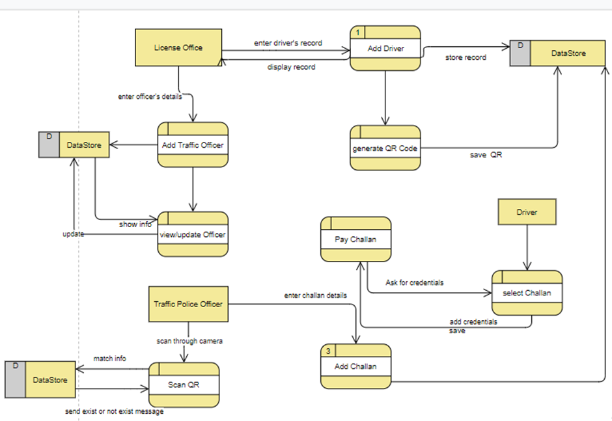
Working flow

Slide 6
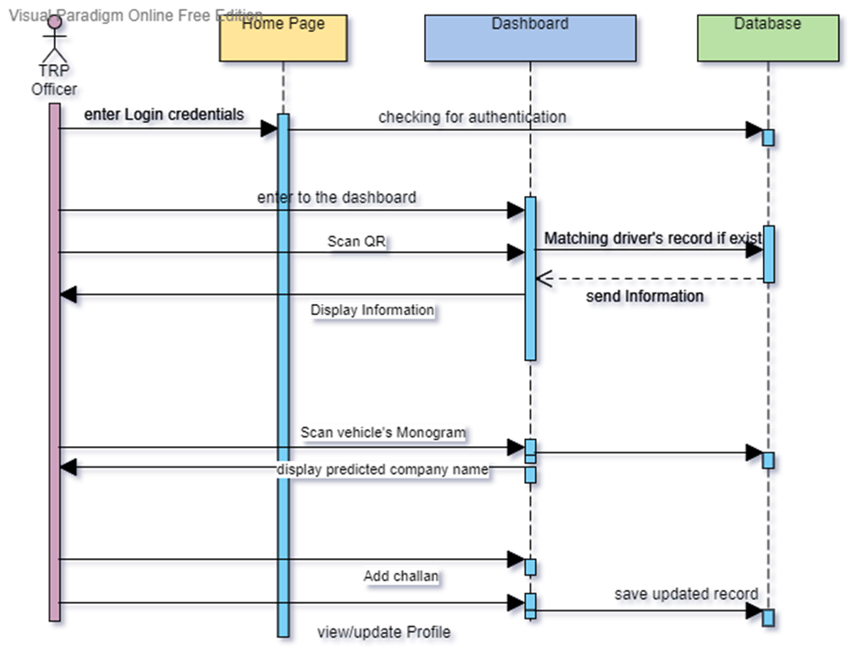
TRP Officer Sequence Diagram

Slide 7
Applications And Comparison Table
Functionality | QR based License Detection (Proposed) | Driving License Verification Pakistan | Scanner-Driver’s license scanner | DMV Driver License Scanner & Decoder, Reader
Scan QR Code | ✔ | ✖ | ✔ | ✔
Scan vehicle’s Monogram | ✔ | ✖ | ✖ | ✖
Match info with driver’s database | ✔ | ✔ | ✖ | ✖
Detect Fake license | ✔ | ✔ | ✖ | ✖
Add/remove employees and drivers in the DB | ✔ | ✔ | ✖ | ✖
_______________________________

Slide 8
Problem statement
Pakistan is a densely populated country where we face heavy traffic on roads So, verification of every vehicle and drivers manually is a difficult task for Traffic Police Officers.
And there is not efficient way of detecting validity of the license given by thy drivers without using special device.
Driver faces problem in keeping all the documents everywhere.
Vehicles verification is also a difficult task for Traffic police as there are many un-registered vehicles.
_______________________________

Slide 9
Objectives
This project is specially designed for traffic police and facilitate them to find out authorized users.
Help them to detect those having fake license.
Our Objective behind this effort is to get rid of extra devices for scanning and verifying license.
Drivers do not have to carry their License all the time.
_______________________________

Slide 10
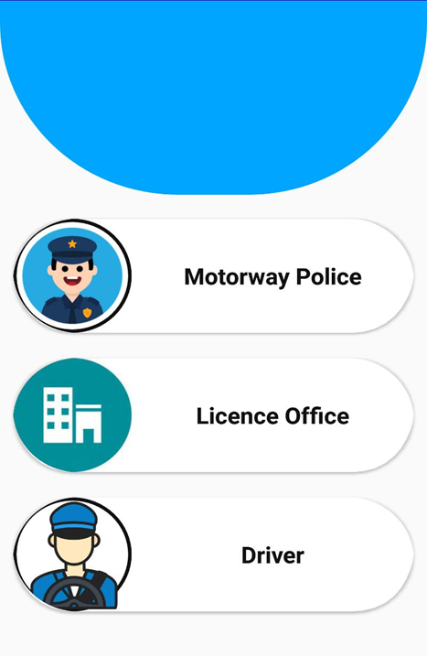
Interface
Home Screen
_______________________________
_______________________________
10

Slide 11
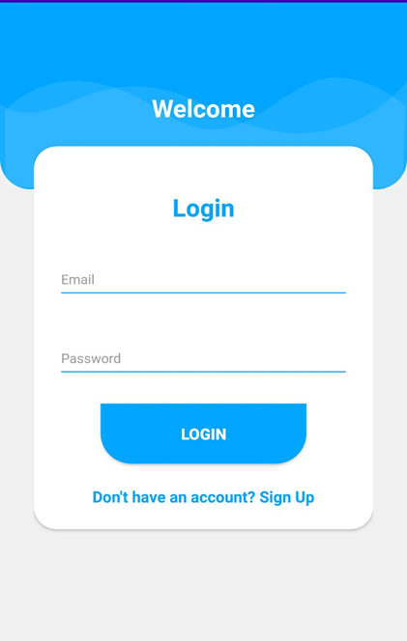
Login Activity:-
_______________________________
_______________________________
11

Slide 12
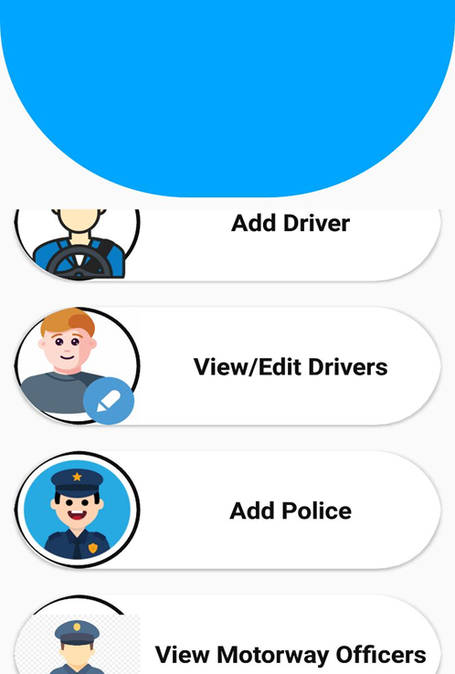
Add driver and police Record (License Office Dashboard)
After login page, the registry of police and driver page will appear to the license office. Here now the record of driver and police is registered so that it can easily be detected by monogram and QR code later by police officer.
_______________________________
_______________________________
12

Slide 13
Driver/Police Registry
_______________________________
_______________________________
13

Slide 14
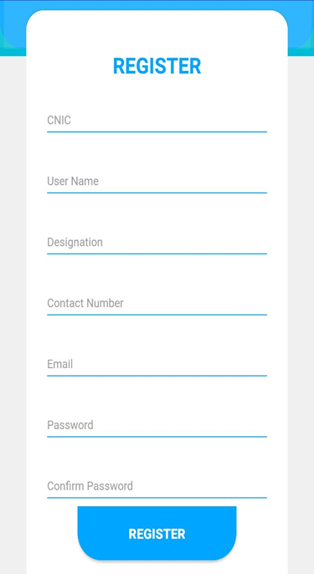
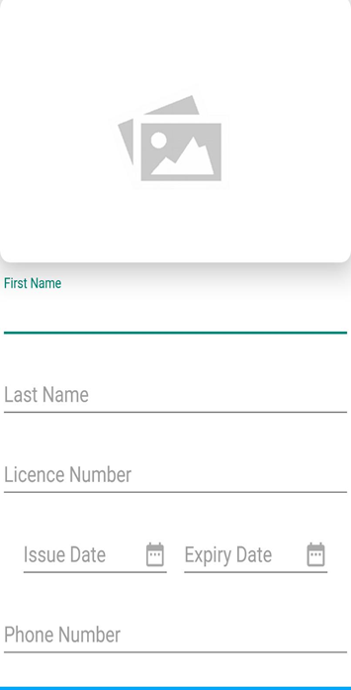
Police Registry
Driver Registry.
_______________________________

Slide 15
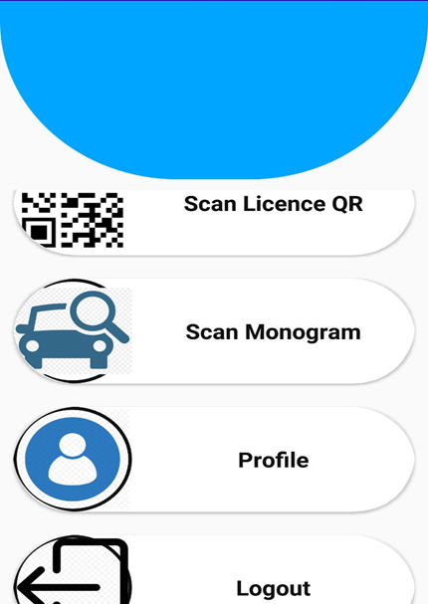
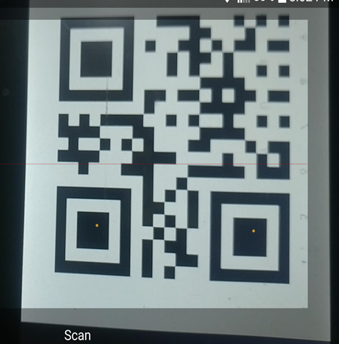
Dashboard
Scan QR Code
_______________________________

Slide 16
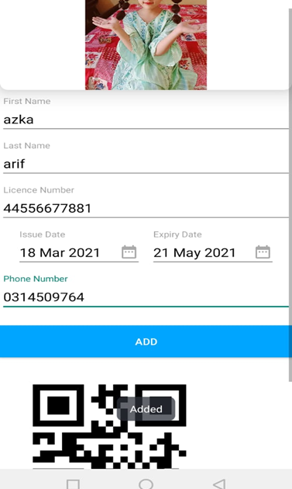
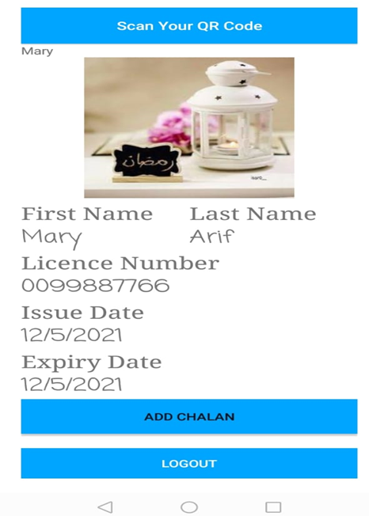
Adding driver and Scanning QR Code
_______________________________
_______________________________
16

Slide 17
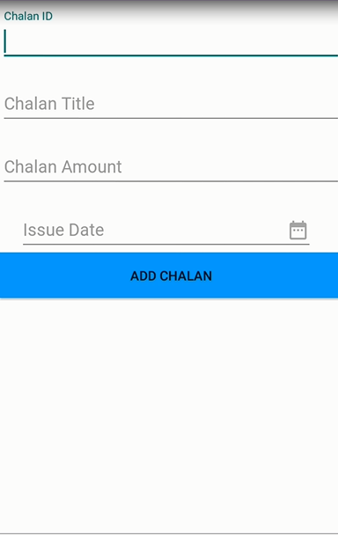
Add Challan
_______________________________
17

Slide 18
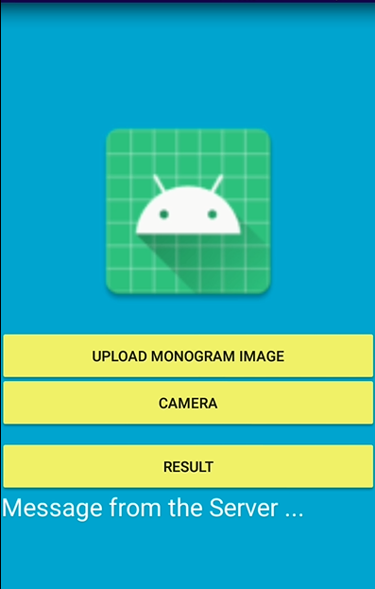
Scan Monogram (Police Dashboard) Police Officer can also scan vehicle’s Monogram to predict vehicle’s company either it is fake or original.
_______________________________
18

Slide 19
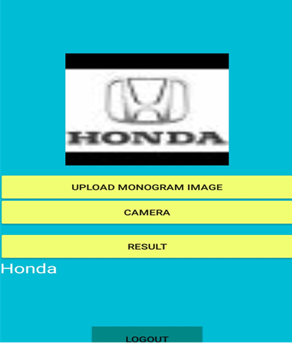
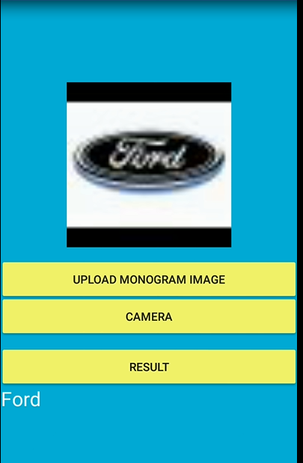
.
_______________________________
_______________________________
19

Slide 20
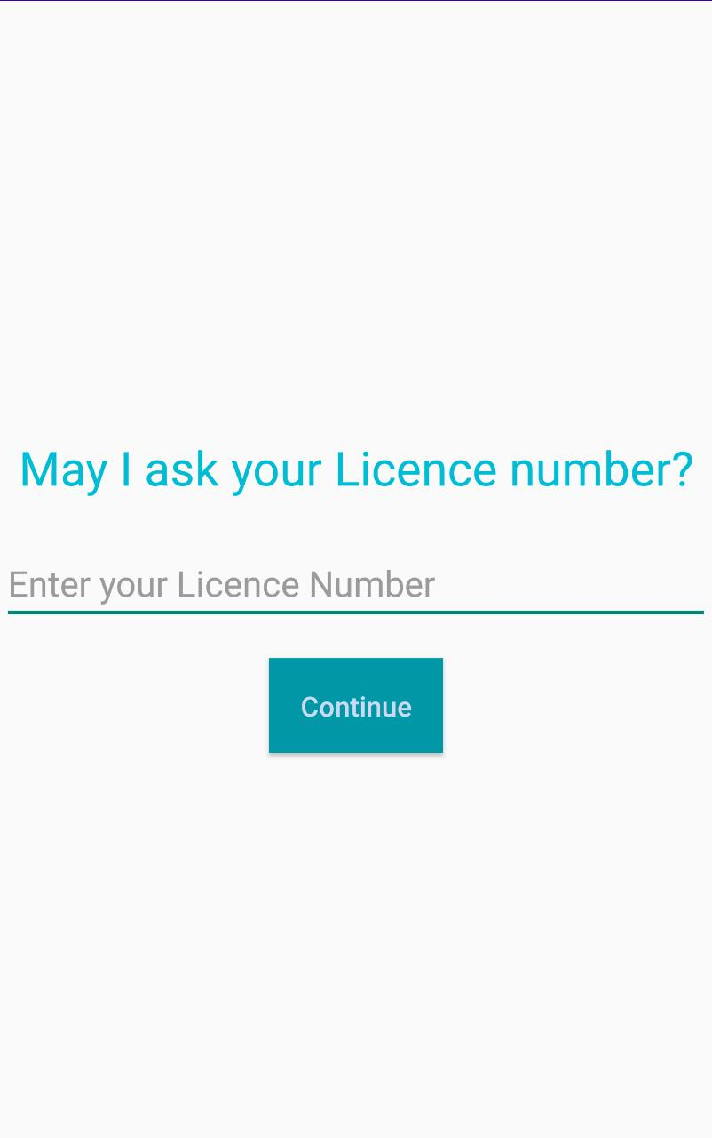
Driver Scan directly from verification code
_______________________________
20

Slide 21
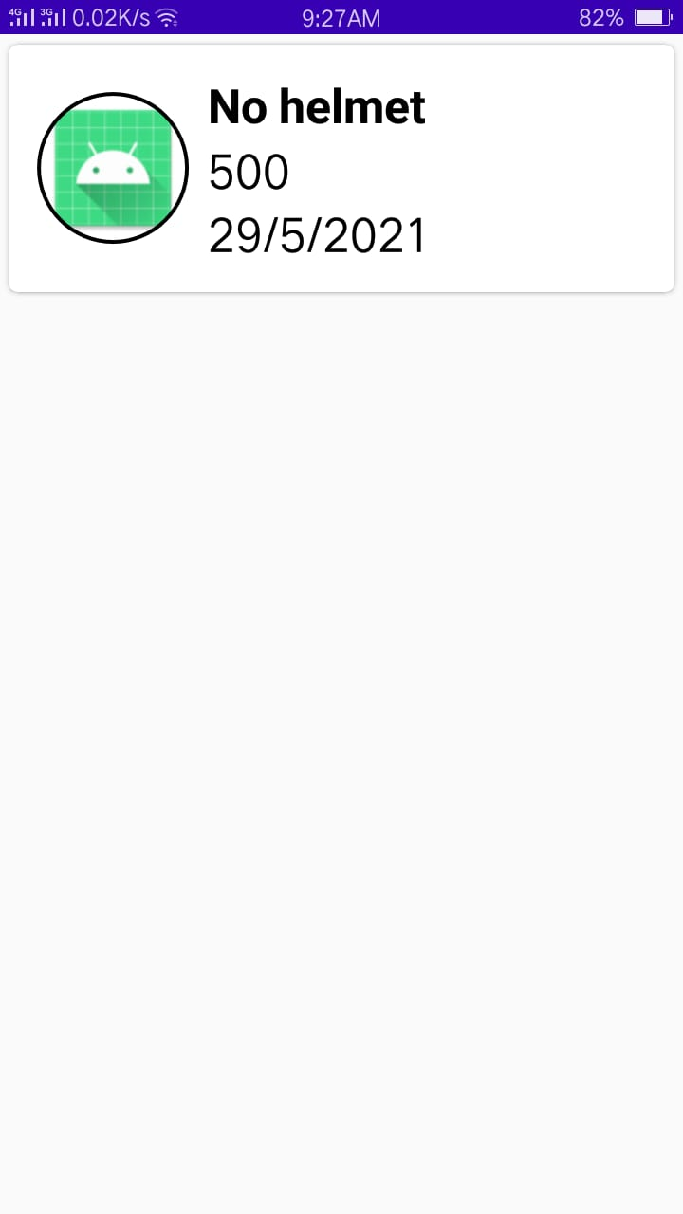
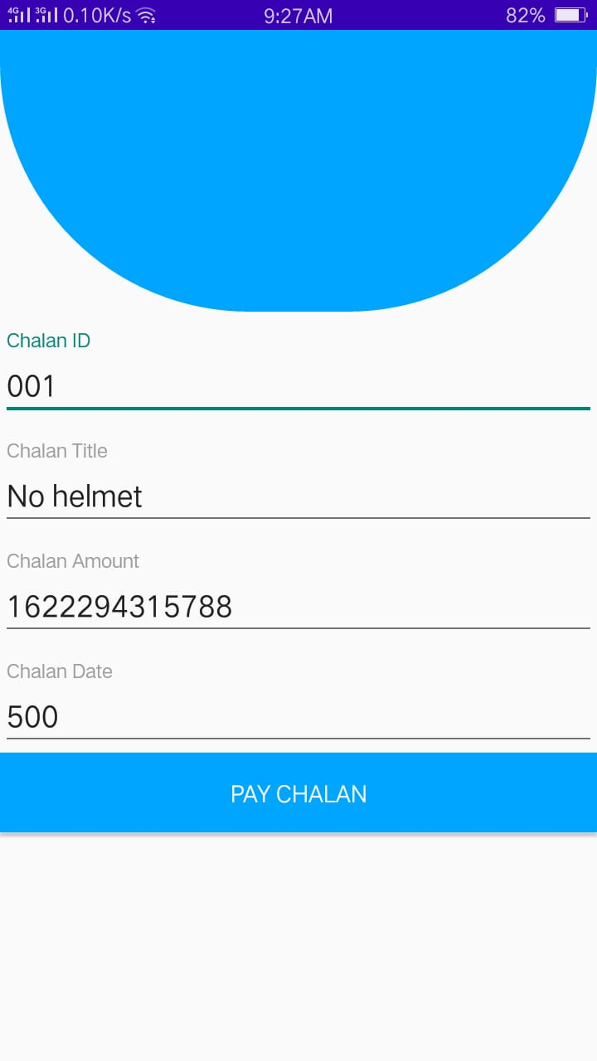

Slide 22
Development Requirements
Software Requirements dependence:
IDE: Android Studio 3.5
Programming language: JAVA , Python.
Database: Firebase
Tools:
JDK
SDK
Jupiter notebook
PyCharm
Hardware Requirements dependence:
Smart Mobile Phone

Slide 23
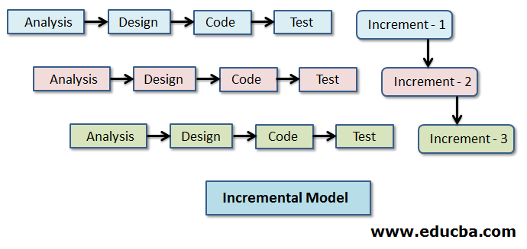
Methodology
We are using Incremental Methodology for our system. Purpose of choosing this methodology is that we are developing in increments so if changes are required, we can change according to our needs.
Easy identified errors of the system and removed early, and the system will progress without any errors.
During this practice, any suggestion by our supervisor on the working of the system we can easily change and implement.
Test after every increment will ensure the working of the system as if it is working efficiently or not.
It is flexible and less expensive to change requirements and scope.
_______________________________

Slide 24
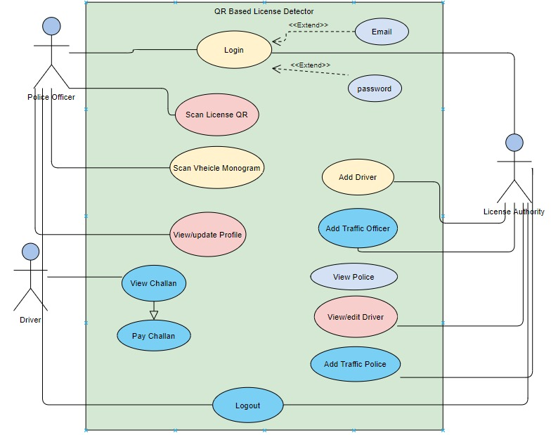
USE CASE DIAGRAM:
A use case diagram that models the functionality of a system using actors and use cases.

Slide 25
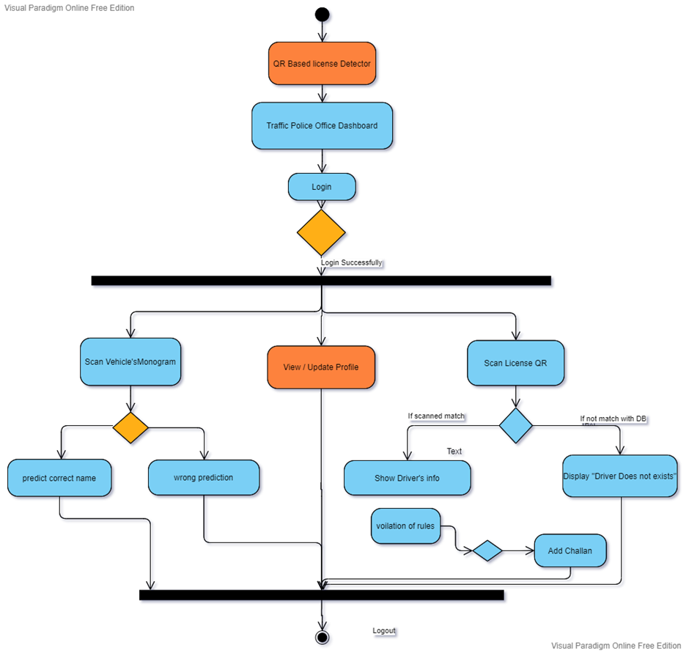
TRP officer activity diagram

Slide 26
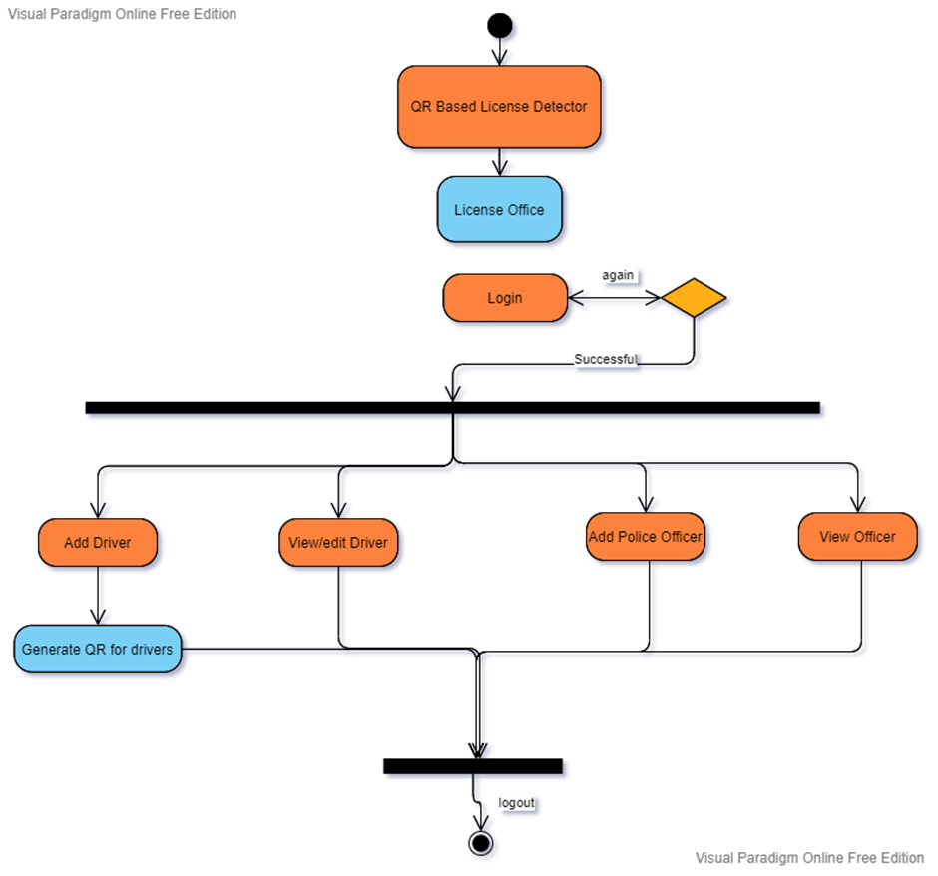
License Office activity

Slide 27
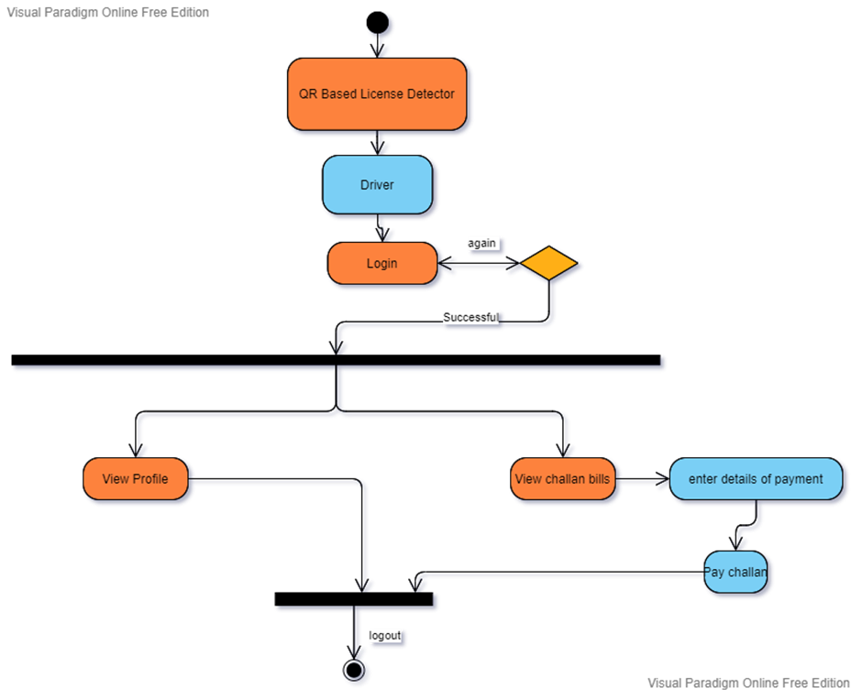
Driver

Slide 28
Modern tools
Tools | Version | Rationale
Android studio | 3.5 | IDE
Firebase | 2018
MS Word | 2019 | Documentation
MS Power Point | 2019 | Presentation
Technology | Version | Rationale
Python | 3.7.0 | Programming language
Java | 3.8 | Programming language
Android Mobile | 8,9,10 | Testing Purpose
_______________________________

Slide 29
Benefits
Quick way of verification:- Since it just take a few seconds to scan monogram and QR. Plus the probability of negligence in manual checking of documents also eliminates.
Documents will remain intact always:-The driver will not have to worry about misplacing/losing and forgetting their documents while on the go.
Checking become more authentic:- It is almost impossible to bypass the verification process facilitated by a QR code. Hence with this system Traffic police will be able to authenticate the identify of driver and vehicle with ease.
_______________________________

Slide 30
References
[1]Ihekweaba Chukwugoziem, Aru Okereke Eze, E. Chiaghana Chukwunonso, International Journal of scientific and engineering research ISJER, A Quick Response (QR) code generator with mobile scan application for mobile network recharge options, 10, ( 2019).
[2] S.R. Bharamagoudar, R.B. Geeta, S.G. Totad, Journal at International journal of advanced research in computer and Communication engineering “Web based student information management system” 2 (2013).
[3] Md. Sanaul Haque, Richard Dybowski, at First International Conference on systems Informatics, Modeling and Simulation “Advanced QR Code based Identity card: A new era for generating student ID card in developing countries” (2014).
[4] SmitaPatil, ShrutiDesurkar,DipaliSanas; “An Intelligent Ticket Checker Application for Train using QR Code”; International Journal of Computer Applications, (2016), pp.15-20.
_______________________________

